Slide 1
Exploring Salary Trends in Data Science
By: Michael Durning

Slide 2
Background: Stakeholder & Motivation
As HR professionals, hiring managers, and data science team leads, understanding salary trends in data science is crucial for making informed decisions about talent acquisition, salary negotiations, and compensation structures.
Data science is a rapidly evolving field, with increasing demand for qualified candidates. In order to attract top talent, organizations need to offer competitive salaries that match industry standards. According to the 2024 Glassdoor salary report, data science professionals with more experience, specialized job titles, and the option to work remotely often receive higher salaries. This data shows that key factors, such as experience and job title, are vital for developing effective compensation packages.
https://www.glassdoor.com/Salaries/data-scientist-salary-SRCH_KO0,14.htm

Slide 3
Research Question
How do key factors such as experience level, job title, company size, remote work ratio, and geographic location affect salaries in the data science field?
This question is important because it helps individuals and companies make informed decisions in the competitive data science field. It aids in career planning, salary negotiation, job market strategies, recruitment decisions, addressing pay disparities, and tracking industry trends. Understanding how factors like experience level, job title, company size, remote work, and geographic location affect salaries empowers professionals to achieve their financial goals and helps employers attract and retain top talent.

Slide 4
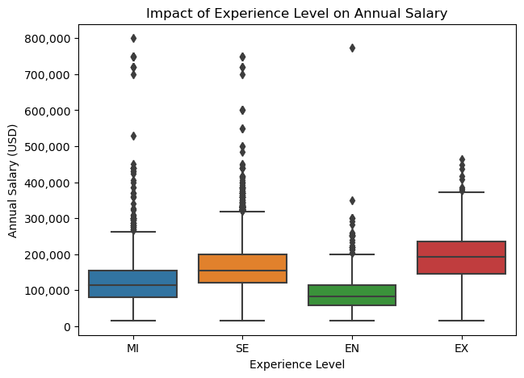
Visualization of Experience Level’s Impact on Annual Salary
Entry-level (EN): Roles have lower median salaries, and their salary range is more narrowly grouped.
Mid-level (MI) & Senior (SE): Both positions have a wider salary spread, which shows some salary growth.
Expert (EX): Roles show the highest salaries with outliers representing top earners.

Slide 5
Hypothesis & Predictions
Hypothesize that experience level and job title are expected to be the most significant predictors of salary in data science, with company size, remote work flexibility, and geographic location playing secondary roles.
Predict that higher salaries will correlate with advanced experience levels, specialized job roles, remote work options, larger company size, and certain geographic locations.

Slide 6
Methods: Data Source
The dataset used for this analysis is Data_Science_Salaries.csv, which includes salary data for 15,000 data science professionals from various industries and regions.
It contains several key features, including experience level, job title, company size, remote work options, and geographic location.
This dataset is valuable because it provides a comprehensive view of salaries across a wide variety of data science positions and locations, making it ideal for understanding how factors like experience, job title, and location affect pay.
https://www.kaggle.com/datasets/yusufdelikkaya/datascience-salaries-2024

Slide 7
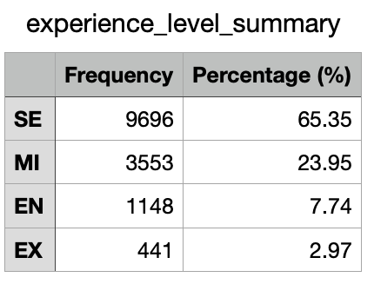
Experience Level Distribution
This table shows the breakdown of experience levels within the dataset, helping to visualize how the data is distributed.
The dataset contains a majority of Senior roles, making up over 65% of the data. Mid-level roles account for nearly 24%, while Entry-level and Expert roles make up 7% and 2%, respectively.
This distribution is important when considering how salary trends are predicted, as the larger share of Senior roles will drive up the overall salary range in the dataset.

Slide 8
Caveats & Data Collection
Caveats:
The data is self reported, which may introduce potential biases or errors from individual reporting.
Certain geographic location factors may not completely reflect cost of living differences, which can influence salary expectations in different regions.
Outliers, particularly for high-paying roles, were kept to reflect the complete range of salary data, though they could skew results.
Data Collection:
This dataset is anonymized, protecting privacy while providing valuable insights into salary patterns across the industry.

Slide 9
Data Cleaning & Feature Selection
Data Cleaning:
Removed duplicate entries to guarantee unique records.
Salary values were standardized to USD for consistency across regions.
There were no significant missing values in the dataset, and outliers were kept to reflect the full salary range, particularly for high-paying roles.
For feature selection, we focused on key variables such as experience level, job title, company size, remote work ratio, and geographic location, as these factors are widely recognized as important in determining salary trends in data science roles.

Slide 10
Final Dataset Overview & Modeling Approach
Final Dataset Overview:
The final dataset contains 15,000 observations and 11 features, with salary as the response variable.
The response variable, salary, was chosen because it directly reflects the compensation trends across different job titles, experience levels, and locations in the data science field.
Modeling Approach:
Started with a Linear Regression model to explore basic relationships between salary and key features.
Then used more advanced models such as Random Forest and Gradient Boosting Machines to identify non-linear relationships and interactions between features.
Linear Regression is used for its simplicity and interpretability, while Random Forest and GBM are powerful models that can better handle complex patterns and interactions in the data.

Slide 11
Findings: Best Model
Best Model:
The Gradient Boosting Machine is currently the best performing model for predicting salary trends in data science roles.
It outperforms other models, including Random Forest, due to its ability to identify complex, non-linear relationships between features.
GBM's strength lies in modeling interactions between features, which plays a significant role in predicting salary in this dataset.
Model Performance:
The R2 score for GBM is high, showing that the model accounts for a substantial amount of variation in the salary data.
The Mean Squared Error is lower for GBM compared to Random Forest, showing that its predictions are closer to the actual salary values.

Slide 12
Key Takeaways
Experience level and job title are the most significant predictors of salary, with seniority and specialization driving higher compensation.
Larger companies tend to offer higher salaries due to greater resources and competitive hiring practices.
Remote work flexibility often correlates with higher salaries by providing access to better-paying global opportunities.
Geographic location impacts salaries, with tech hubs like Silicon Valley offering higher pay, though remote work may reduce this effect.

Slide 13
Synthesis
These findings confirm that experience level and job title are the primary factors influencing salary in data science, which supports our research question. Understanding these factors is crucial for developing competitive salary packages and career strategies.
The positive impact of remote work and geographic location highlights the importance of considering these factors when creating compensation packages and career planning.
In summary, the model confirms that experience, specialized roles, and company size are key factors in determining salary, which can help organizations make data-driven decisions about talent acquisition and compensation.

Slide 14
Conclusions: Limitations
Model Limitation:
The model relies on self reported data, which can introduce biases or errors. This makes the results less reliable for accurate salary comparison.
Key factors like industry and education level were not included and leaving them out could reduce the accuracy of the salary predictions. Adding these factors could provide a more complete view of salary trends.
Geographic location and cost of living differences might not be fully accounted for, which can affect the accuracy of salary predictions across different regions. Be cautious when applying these predictions to areas with significantly different costs of living.
Given these limitations, recommend caution when using this model for salary comparison across regions or industries not specifically covered in the dataset.

Slide 15
Recommendations & Next Steps
Recommendations:
To improve the model's accuracy, we recommend adding data on industry and education level, which could help improve salary predictions.
Consider creating models for specific regions to better reflect cost of living and salary differences across locations.
Testing the model with more complete data and hyperparameter tuning could improve predictions, particularly for regions or industries with limited data.
Next Steps:
Next, collect additional data on industry and education level and improve the model using hyperparameter tuning.
Explore the possibility of using the model for salary comparisons within specific industries or regions once it is improved.
Additional testing is needed before the model can be used for final compensation decisions or salary offers, particularly in regions with different living costs.

